Slide 1



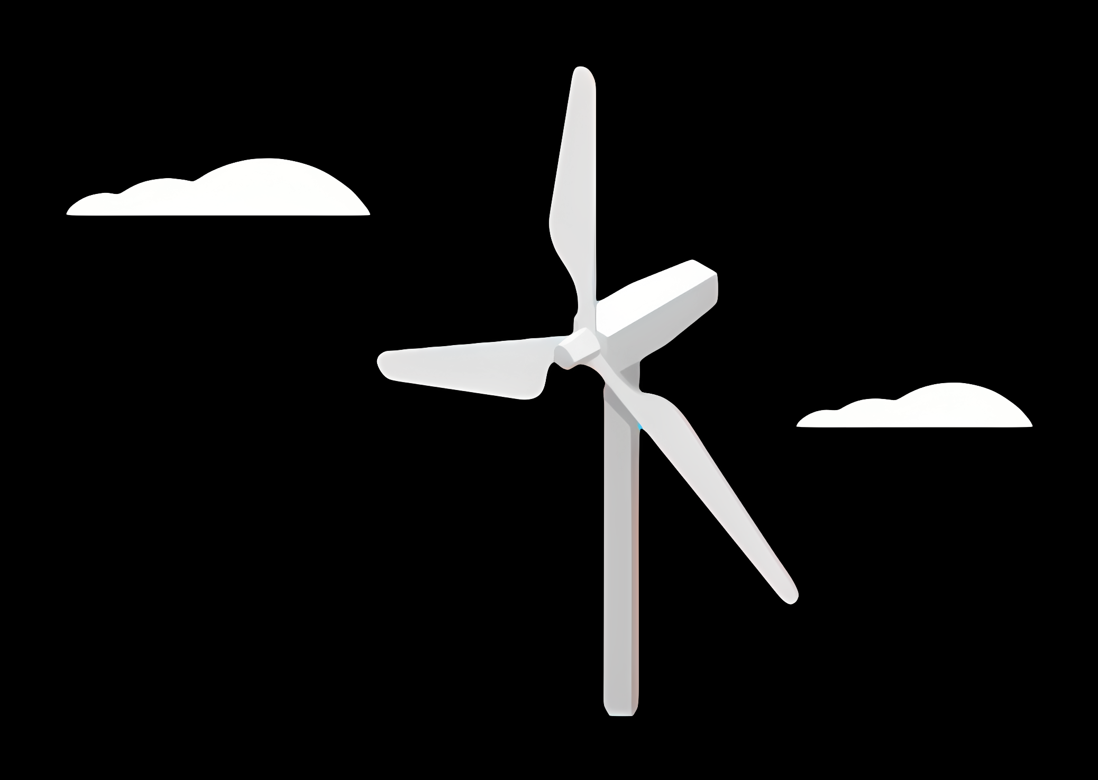
Weekly report: Grid Code Development
Week number: 01
Date: 23/09/2025
Supervisor: Prof. Dr.-Ing. Saiju
Group members: Vijay Simha Reddy Bogala, Josef Rememberger

Slide 2
Tasks and Results of the last weeks
Content
Grid Code – Key Aspects
Research about the grid infrustructure
Deeper insights to international and national standards of Grid Codes
Comparision of German and Syrian grid code
Syrian grid problems
Outlook

Slide 3
Grid Code – Key Aspects
Defines international and national standards for grid connections
Specifies voltage and frequency requirements
Sets grid connection conditions
Includes control energy and reactive power specifications
Defines fault ride-through behavior
Outlines communication and reporting obligations
[1]

Slide 4
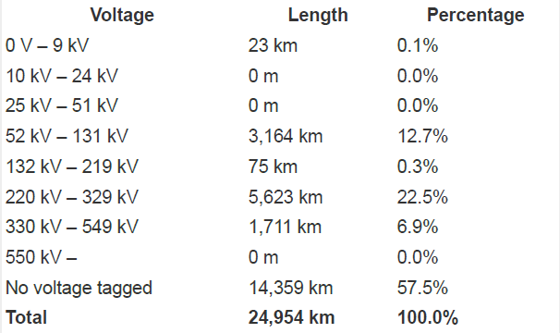
Grid infrastructure
Map of Syria’s electricity infrastructure
Renewables in Installed Capacity
Total share: 20,1 %
Wind: 0.1 % (≈ 11 MW)
Wind within renewables: 0.7 %
Two substantially sized wind farm are existing close to border in Israel
Collected voltage-km chart
[4]

Slide 5
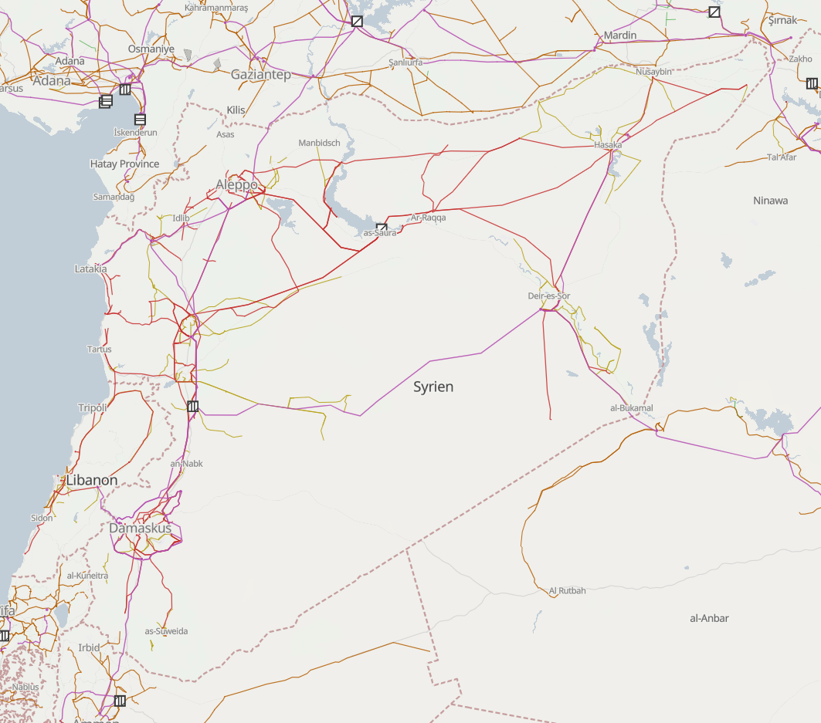
Infrastructure map
[4]

Slide 6
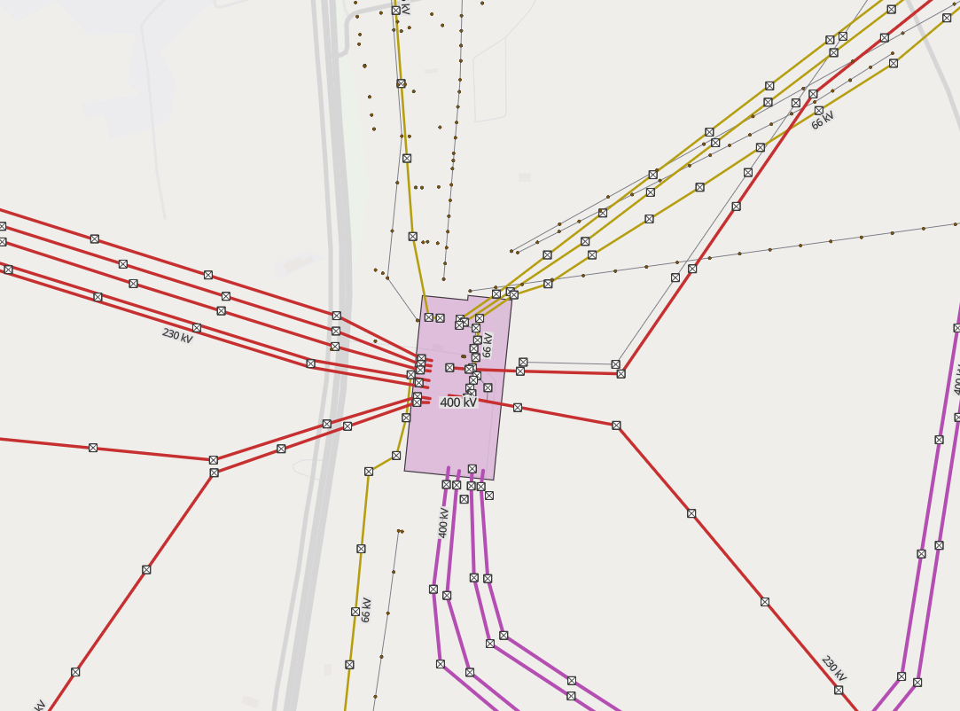
Infrastructure map
Substation
Grid Tower(s)
[4]

Slide 7
DNV-GL standards
Since, IEC 61400-1 is not accessible, DNV-GL is choosen as it is mostly the same
Chapter 8 in the DNV-GL IV I Guideline for the Certification of Wind Turbines Edition 2010 were studied
Details on the requirements for standard turbine are noted and they are
Mostly applicable after the design stage, at choosing from brochures for parts

Slide 8
Grid Code requirements from the PETE
PETE (Public Establishment for Transmission of Electricity)
Paper: Transmission Grid Code (2014)
Content
General Conditions (GC)
Planning Code (PC)
Connection Conditions (CC)
Operating Code (OC1 – OC11)
Scheduling and Dispatch Code (SDC1 – SDC3)
Metering Code (MC)
[2]

Slide 9
Grid Code requirements from the PETE
Voltage levels: 0.4-400 kV
Feed-in limit (20 kV grid): up to 5 MW
DC Injection: ≤ 0.25 % of rated current
Voltage Deviation: +- 3% from nominal
Individual Harmonics (Point of Connection):
MV (20kV): 2.5 %
HV (66 kV): 2.0%
[2], [3]

Slide 10
Comparison german and syrian Grid Code
 | Syria | Germany
Grid frequency | 50 Hz | 50 Hz
frequency working range | 47.5 < X < 51.5 Hz | 47.5 < X < 51.5 Hz
Minimum power factor for WT | 0,98 | 0,95
Maximum amount of renewable energy systems in a certain area | 30 % | -
[3]

Slide 11
Syrian grid problems
War damage
Often power outages
Inefficient
Still heavily reliant on fossil fuels for energy production
[6]

Slide 12
Outlook
Compare the older designs of circuits and control systems of asynchronous to the latest synchronous generator control systems as provided from S. Heier’s textbook
Prepare a checklist of data required from other teams
Design the circuits and control systems and simulate based on the exact details from other teams
Browse brochures for components compliant with IEC or DNV-GL standards to prepare the bill of materials (BOM) and cost estimate
Getting more into Simulink, starting also with Power Factory

Slide 13
Bibliography
Document sources:
[1], Draft World Grid Codes / Trudy Forsyth Wind Advisors Team, 2020 (accessed Sept. 07,2025)
[2], SYRRIAN ARAB REPUBLIC / Ministry of Electricity / PETE / Transmission Grid Code, 2014 (accessed Sept. 08, 2025)
[3], Rules and Conditions for Connecting Renewable Energy Projects to the Transmission and Distribution Networks, 2022 (accessed Sept. 09, 2025)
Website sources:
[4], Open Infrastructure map, https://openinframap.org (accessed Sept. 09, 2025)

